Slide 1
WELCOME TO WEEK3 TUTORIAL !

Slide 2
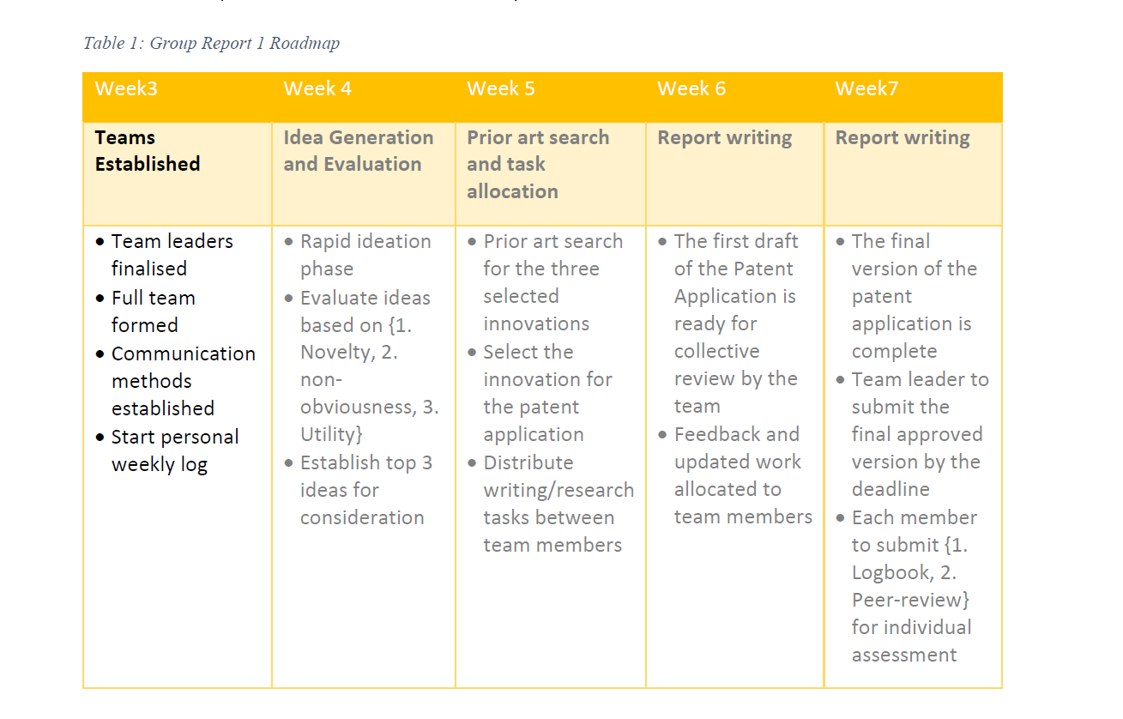


Slide 3
Group Formalisation!
Team Leader, please come here to register for your group!
What is your weekly meeting schedule and a preferred communication strategy?
Please notice that no further changes to the team can be made, and the teams will continue till the end of the semester

Slide 4
What is your key role in the team?

Slide 5




Team Role Clarification
ENTREPRENEURING
PRODUCING
ADMINISTRATING
INTEGRATING

Slide 6


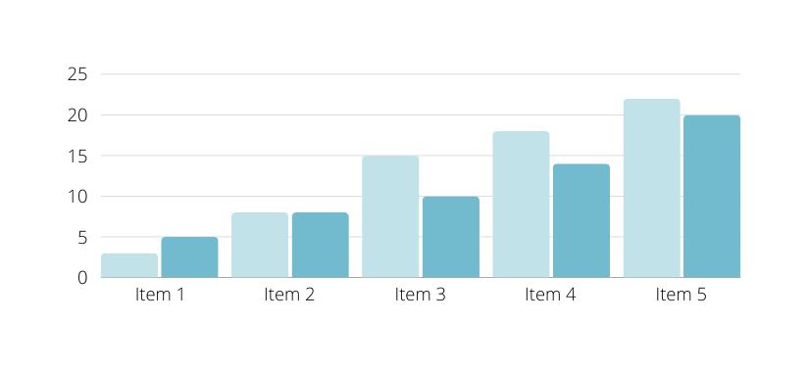
ENTREPRENEURING
identify opportunities in the environment of the
team; related to effectiveness and long term goals.
IT COMPANY - FOUNDER / CEO
Members in this role are responsible for identifying and discovering new business opportunities within the IT company's environment

Slide 7
AIMS FOR
effectiveness while focusing more on the
short term goals and results.
PRODUCTING
IT COMPANY - DEVELOPER
Members focus on achieving short-term goals and delivering results, ensuring that projects are completed on time and meet the expected quality

Slide 8

ADMINISTRATING
RELATED TO
efficiency and short term activities and
goals; developing good routines and
structure in the venture.
IT COMPANY - PROJECT MANAGER
Members in this role focus on enhancing the efficiency of daily operations and organizational structure.

Slide 9

INTEGRATING
RELATED TO CARE FOR
efficiency and long term mind set.
IT COMPANY - HR
IT COMPANY
Members in this role are dedicated to enhancing collaboration and efficiency within the team, while also maintaining a long-term perspective.

Slide 10
The team leader could be ascribed one of the roles – not necessarily the entrepreneuring role.
There could be multiple team members for one role

Slide 11
Let’s prepare for the Assignment 1

Slide 12
Identify your problem
(Not solution)
could be something simple like the problem of finding a parking spot on campus during busy times.....
could be the global/environmental problems like climate change, homelessness, aging, manufacturing......

Slide 13


Weekly Reminder
Remember to write your weekly logbook
Remember to complete the Week 2 quiz before the end of week 3.

Slide 14
What to do next?
Identify a suitable problem your team would like to explore further for the innovation ideation in week
Develop your team’s culture and team dynamics

Slide 15
QUESTION?

Slide 16
Feel free to contact me if you have any question!
elane.peng@canberra.edu.au

